Slide 1

Machine Learning project on FIFA 2018 Statistics
Term 2 – Project
By – Diwjen Philixon(diwjenp@gmail.com

Slide 2
1. Introduction.
2. Problem Statement.
3. Exploratory Data Analysis
4. Training and Classification
5. Conclusion
AGENDA

Slide 3
1. Introduction
In the Exploratory Data Analysis we are using Python skills on a structured data set including loading, inspecting, wrangling, exploring, and drawing conclusions from data.
The notebook has observations with each step in order to explain thoroughly how to approach the data set.
Machine Learning algorithms are used to predict the Man of the Match.

Slide 4
2. Problem Statement
Aim is to Predict the Man of Match in the tournament by using Machine Learning algorithms.

Slide 5
3. Exploratory Data Analysis
Finding the best data from the dataset ?
Finding the best feature for the classification of the survival status?
Finding the co-relationship between the columns?
How many patients survived.

Slide 6

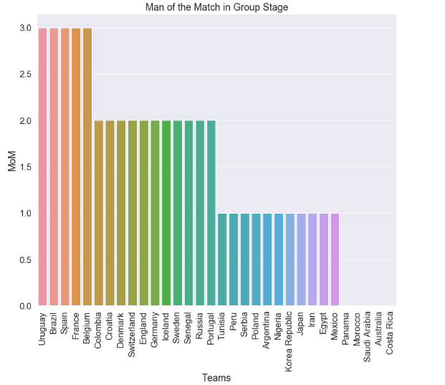

Slide 7
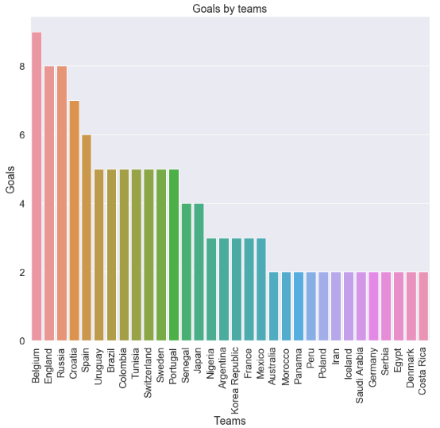
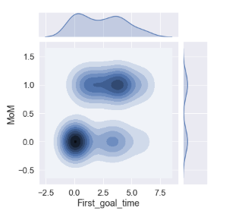

Slide 8
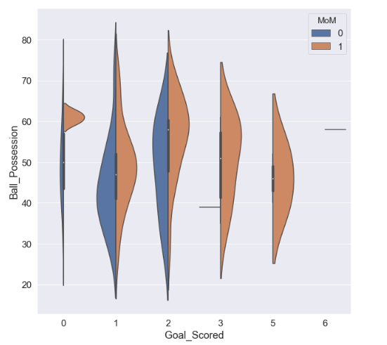

Slide 9
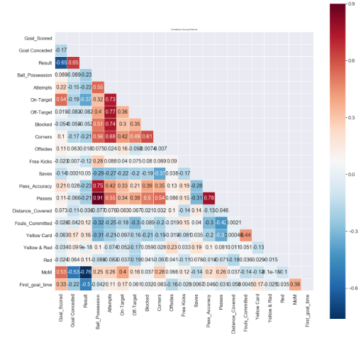

Slide 10
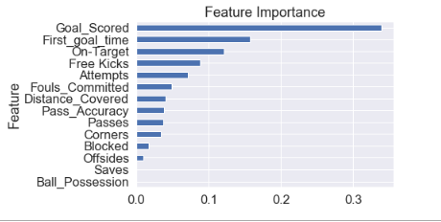
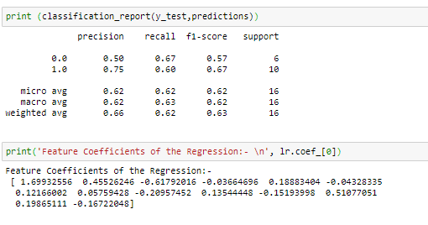
Training and Classification
Random Forest
Decision Tree
Best mean CV accuracy: 0.875
Holdout test set accuracy: 87.5%
Logistic Regression
Test accuracy: 0.625
Best mean CV accuracy: 0.875
Holdout test set accuracy: 0.75
Best parameters: {'criterion': 'entropy', 'max_depth': 2, 'n_estimators': 15, 'random_state': 69}
The random forest performed the best (looking at cross validation error)!

Slide 11

5. Conclusion
Decision Tree had the best performance with a accuracy score.
It allowed us to understand that the winner of the match is the most important predictor of the Man of the Match, followed by the number of goals scored.
It should be noted that the random forest didn't generalize well to the final test set, scoring only 62.5%. Other features may need to be mined from the data to correct for this.
We obtain 62.5% accuracy using Logistic Regression Model.

Slide 12
Thank You

